Slide 1

Services and Integrations

Slide 2
Agenda
Identify how you can extend the functionality of IBM Cloud Pak for Data
Identify the services that are available in the catalog
Identify the services that are available outside of the catalog
Integrate IBM Cloud Pak for Data with other applications

Slide 3
Services and Integrations
You can extend the functionality of IBM® Cloud Pak for Data by installing services and by integrating Cloud Pak for Data with other applications.

Slide 4
Services in the Catalog

Slide 5
AI

Slide 6
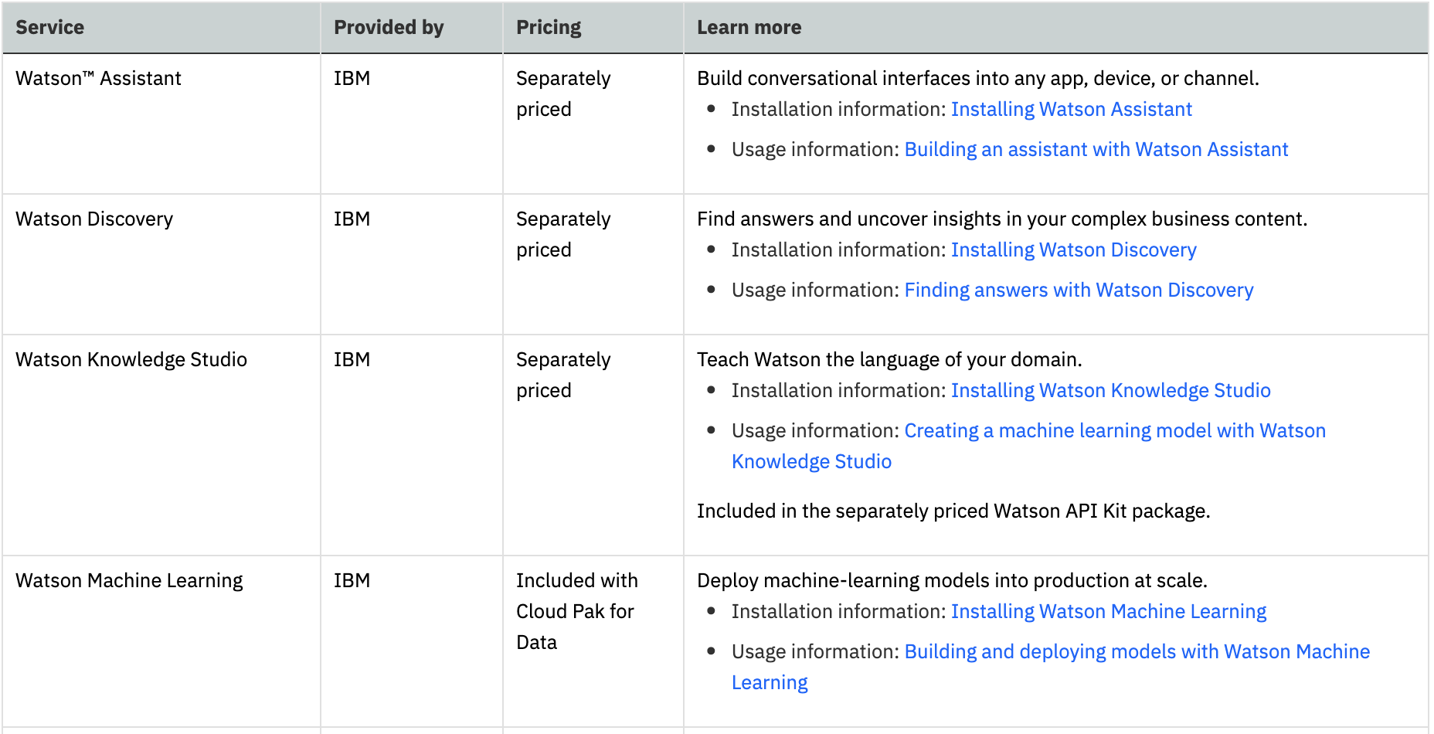

Slide 7
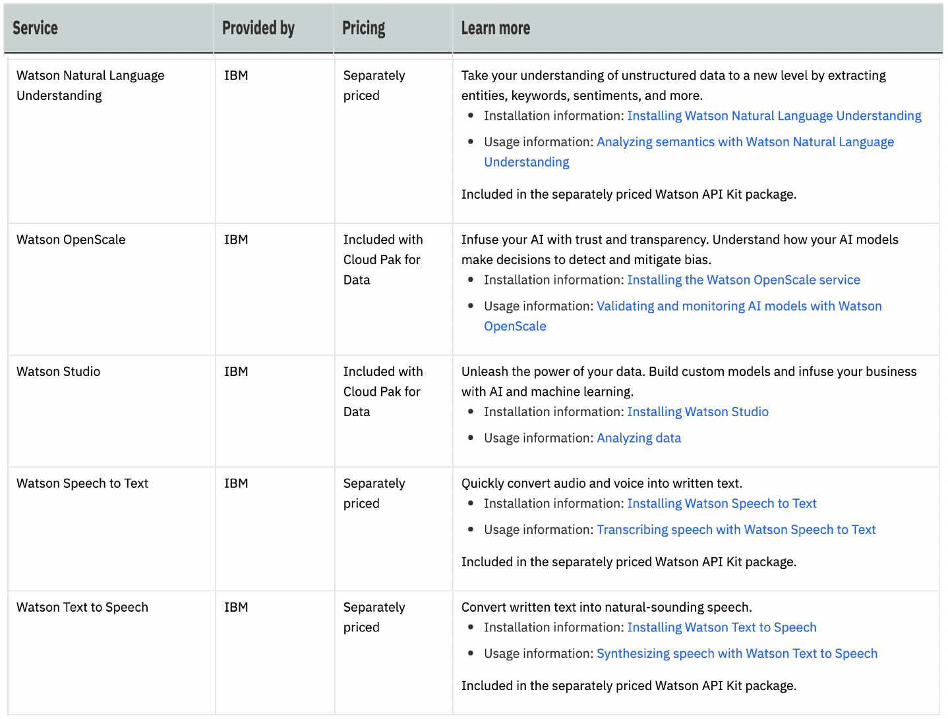

Slide 8
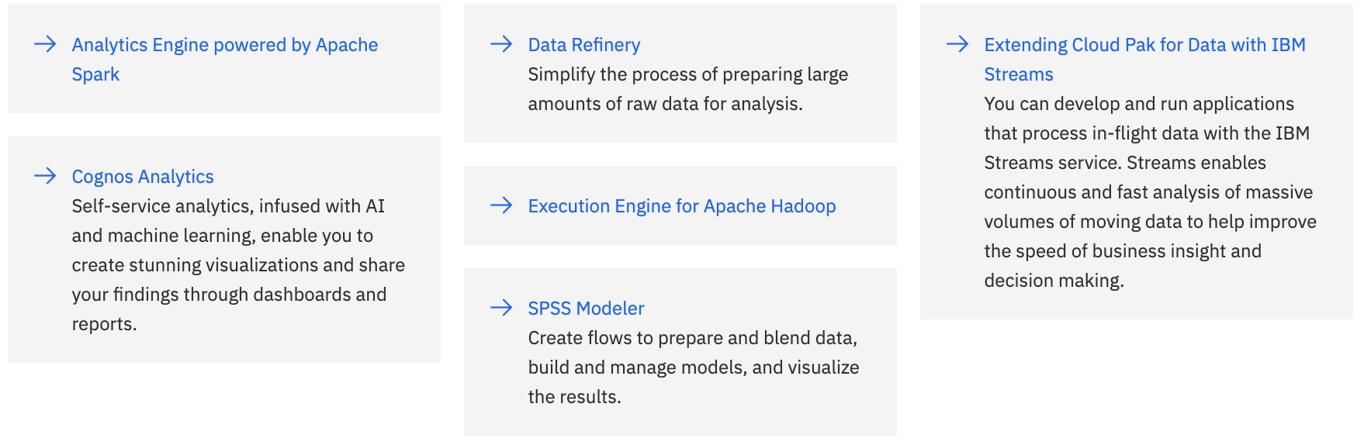
IBM Analytics Services

Slide 9
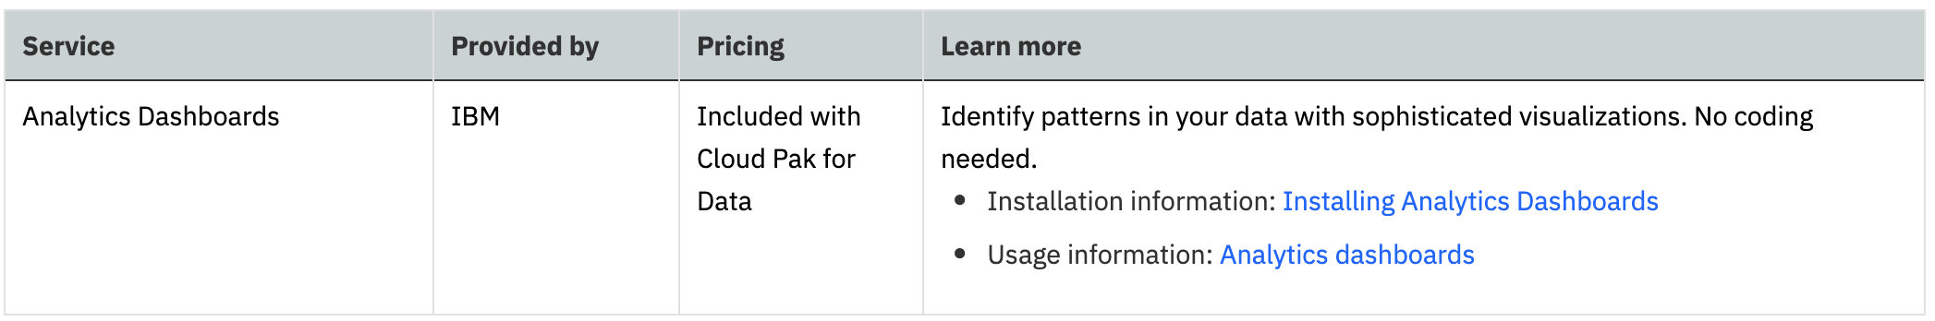
Dashboards

Slide 10
Data Governance

Slide 11
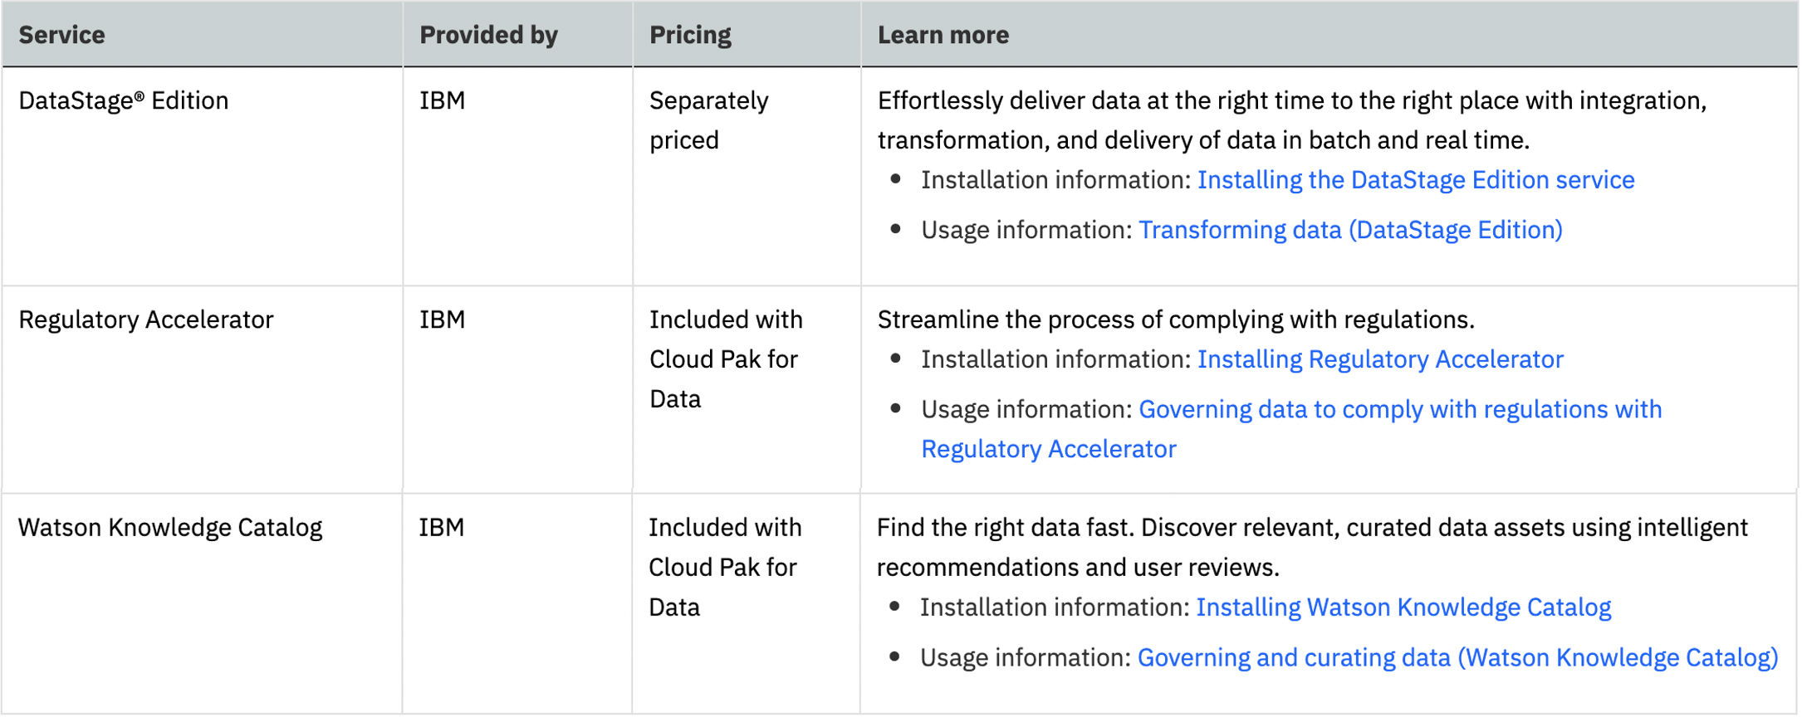

Slide 12
Data Sources

Slide 13
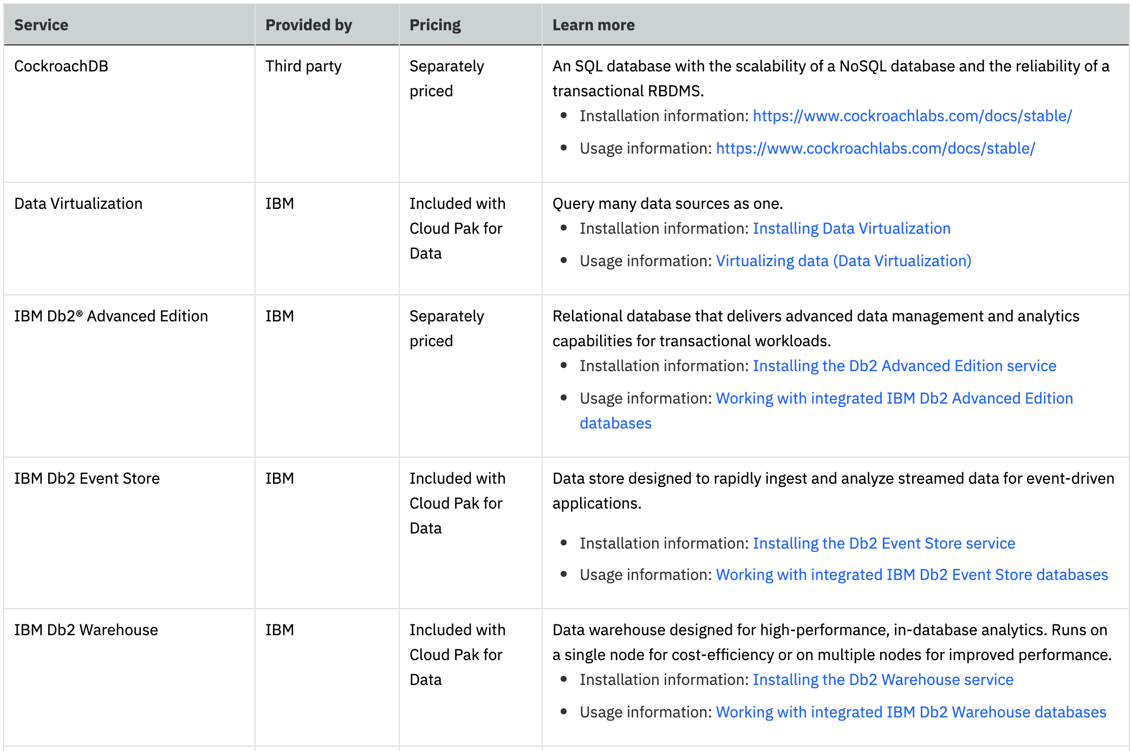

Slide 14
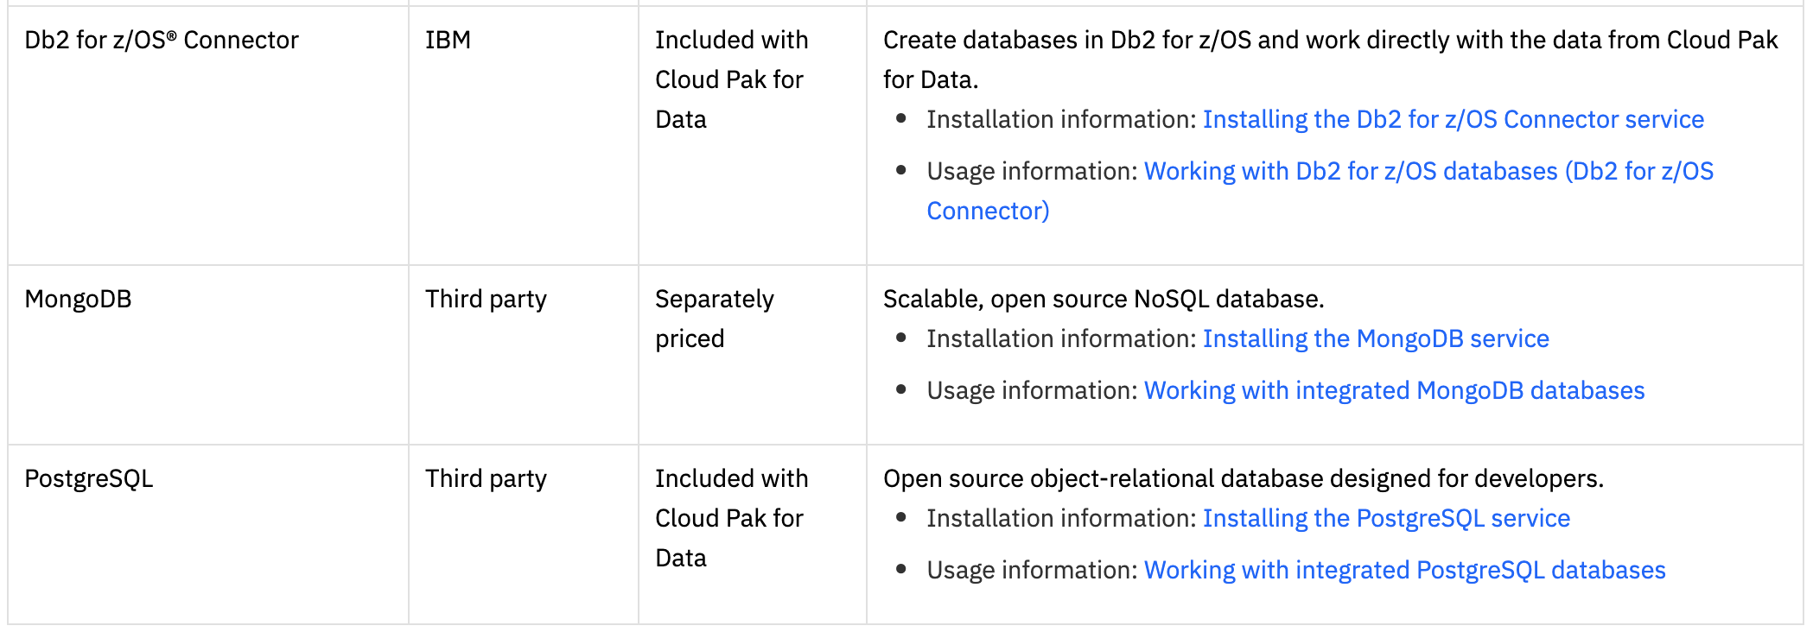

Slide 15
Developer Tools

Slide 16
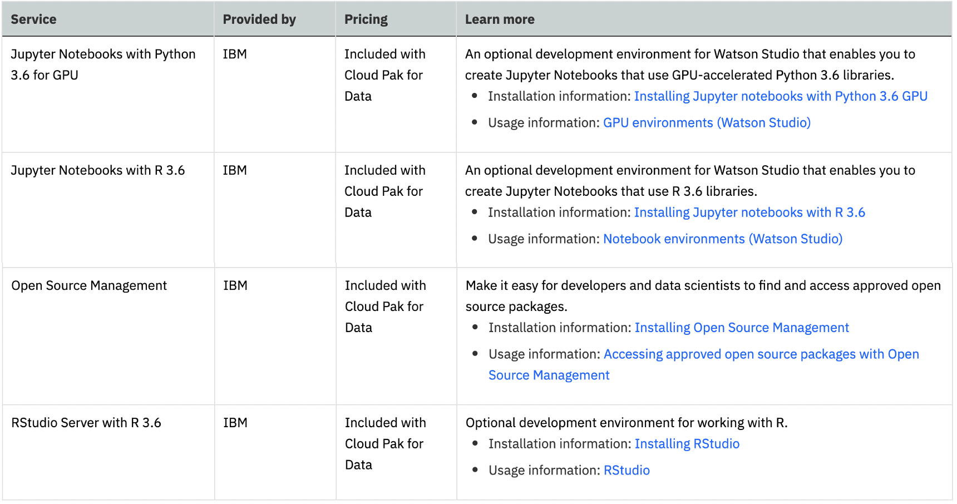

Slide 17
Industry solutions

Slide 18
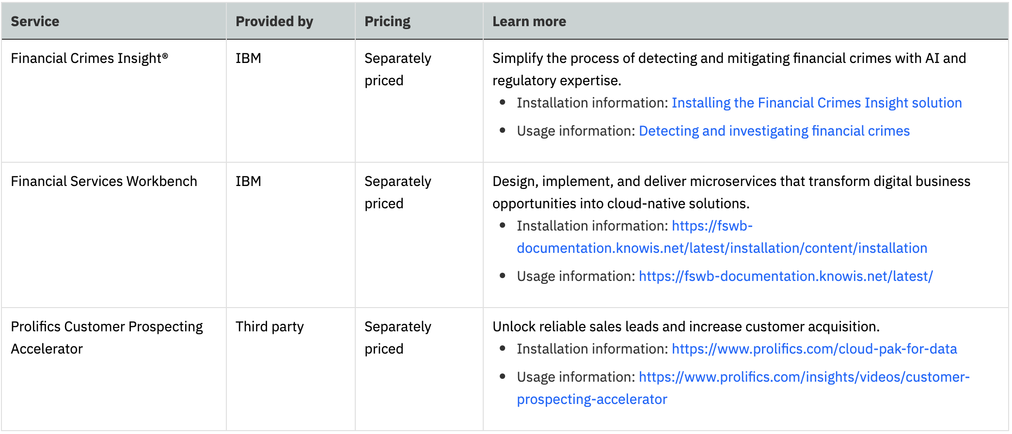

Slide 19
Storage

Slide 20
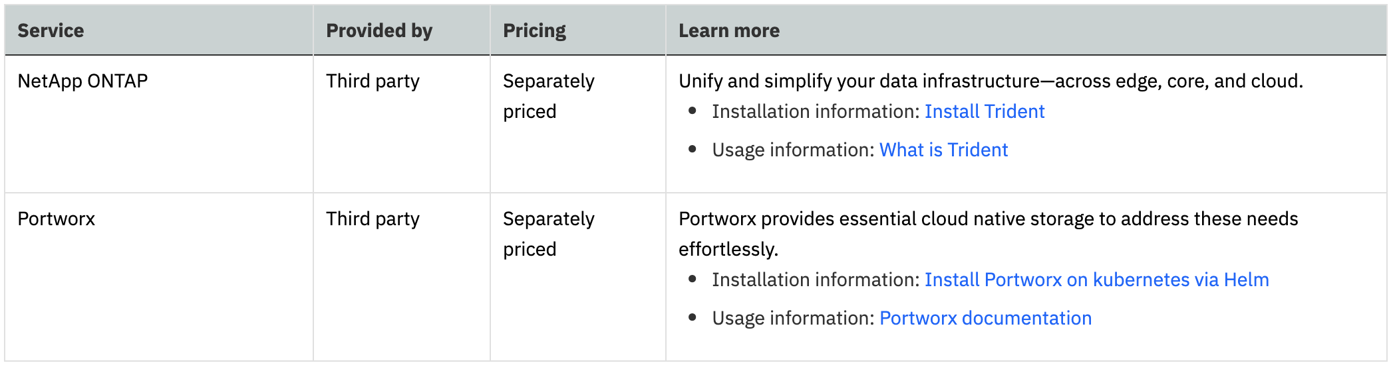

Slide 21
Services outside the Catalog

Slide 22
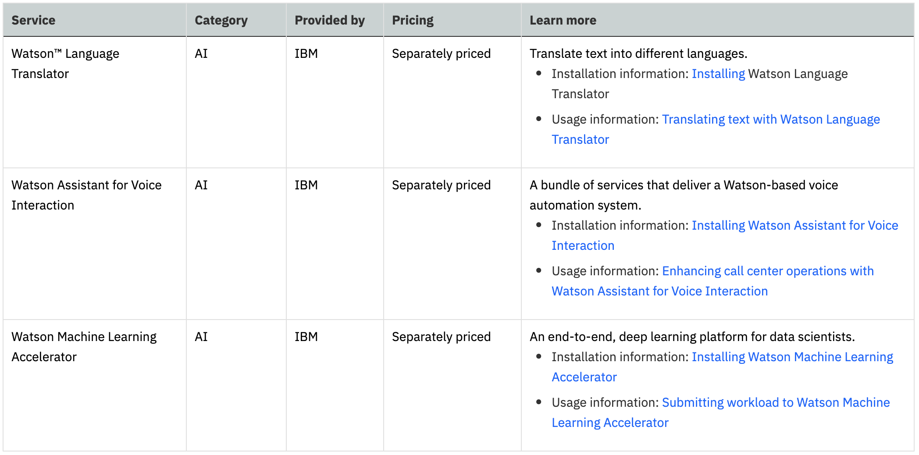

Slide 23
Industry accelerators
The industry accelerators that are provided by IBM are a set of artifacts that help you address common business issues.

Slide 24
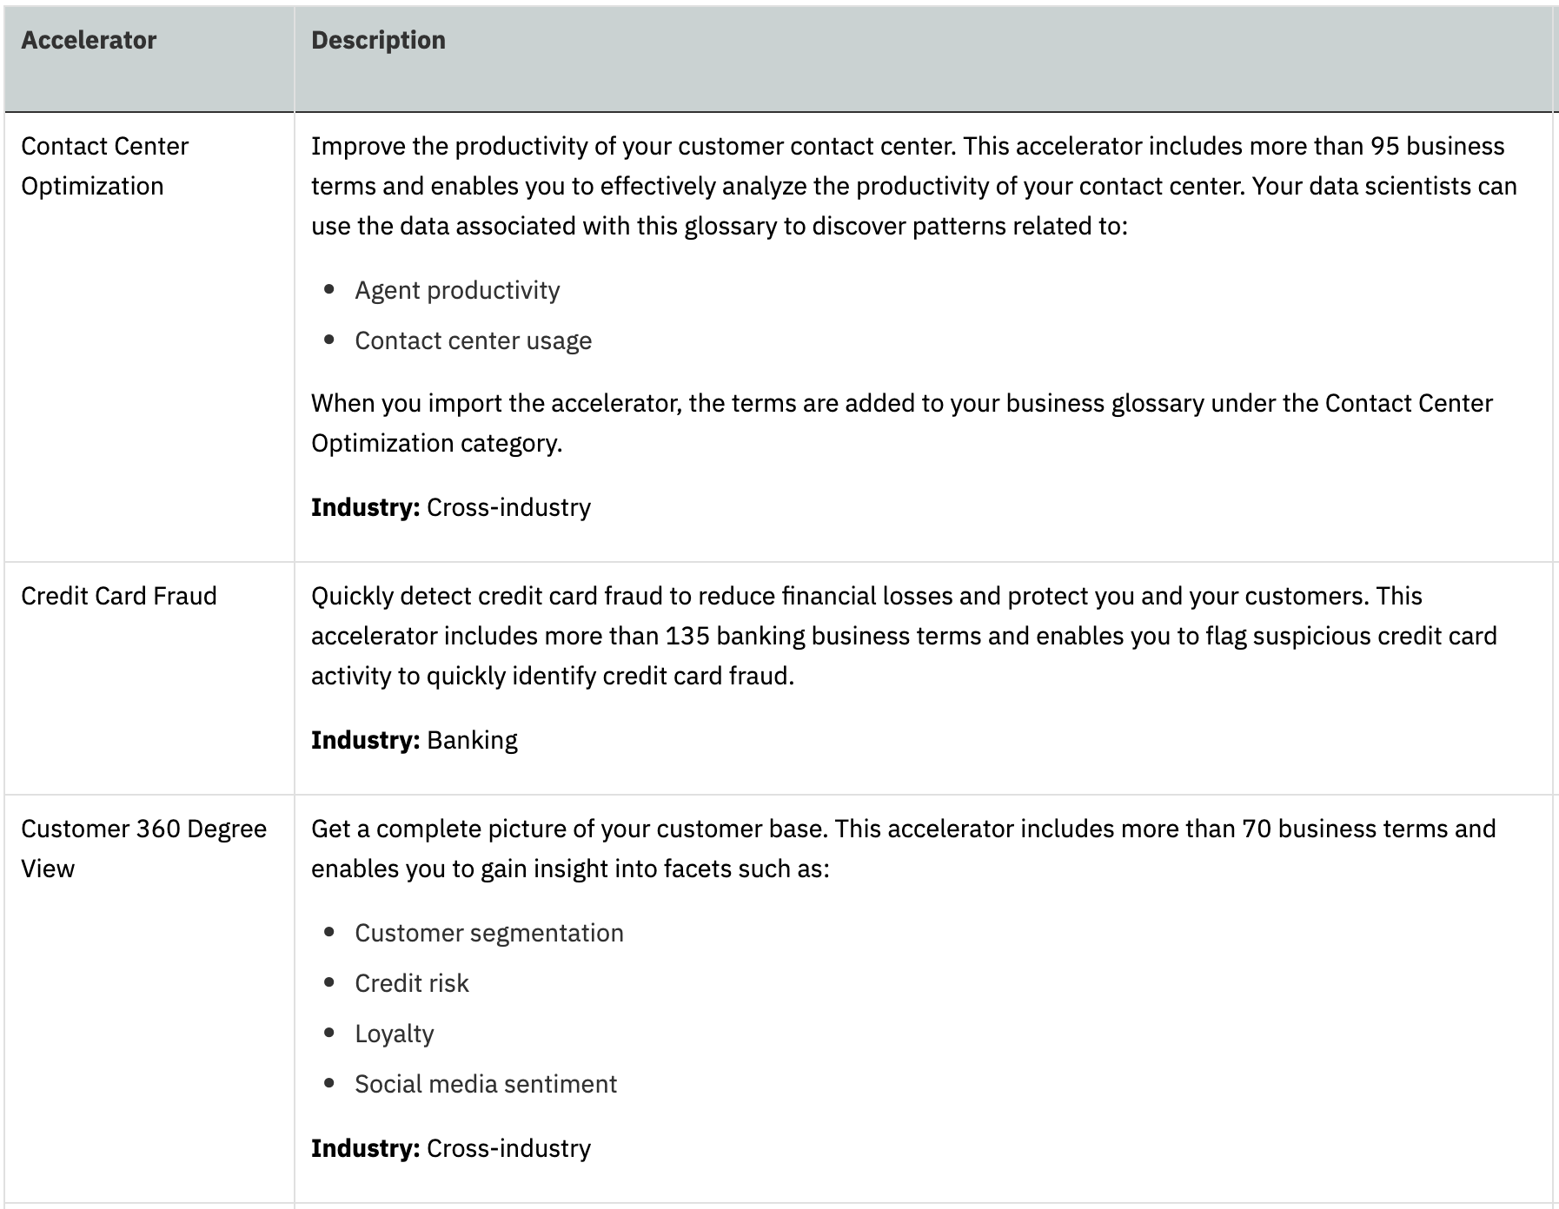

Slide 25
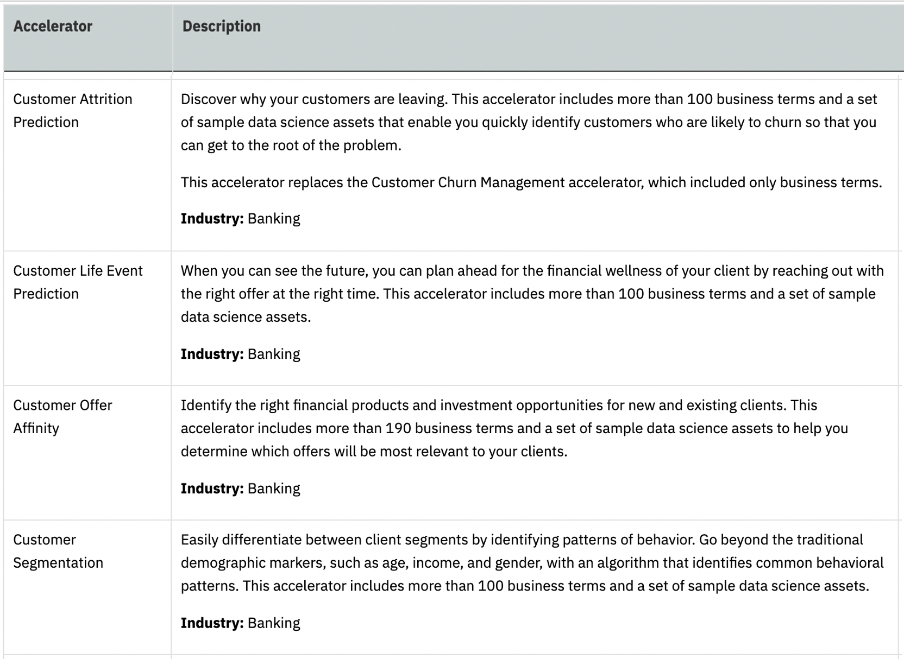

Slide 26
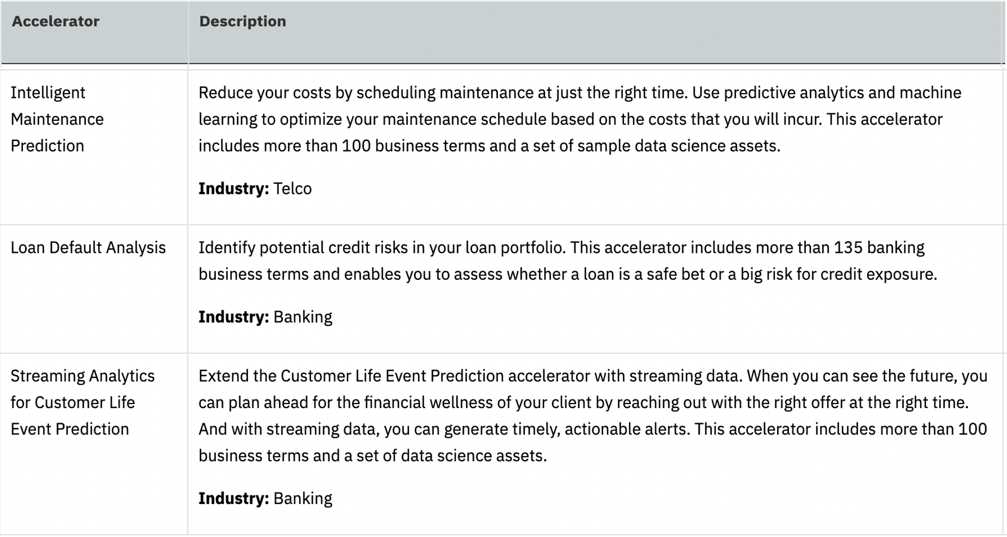

Slide 27
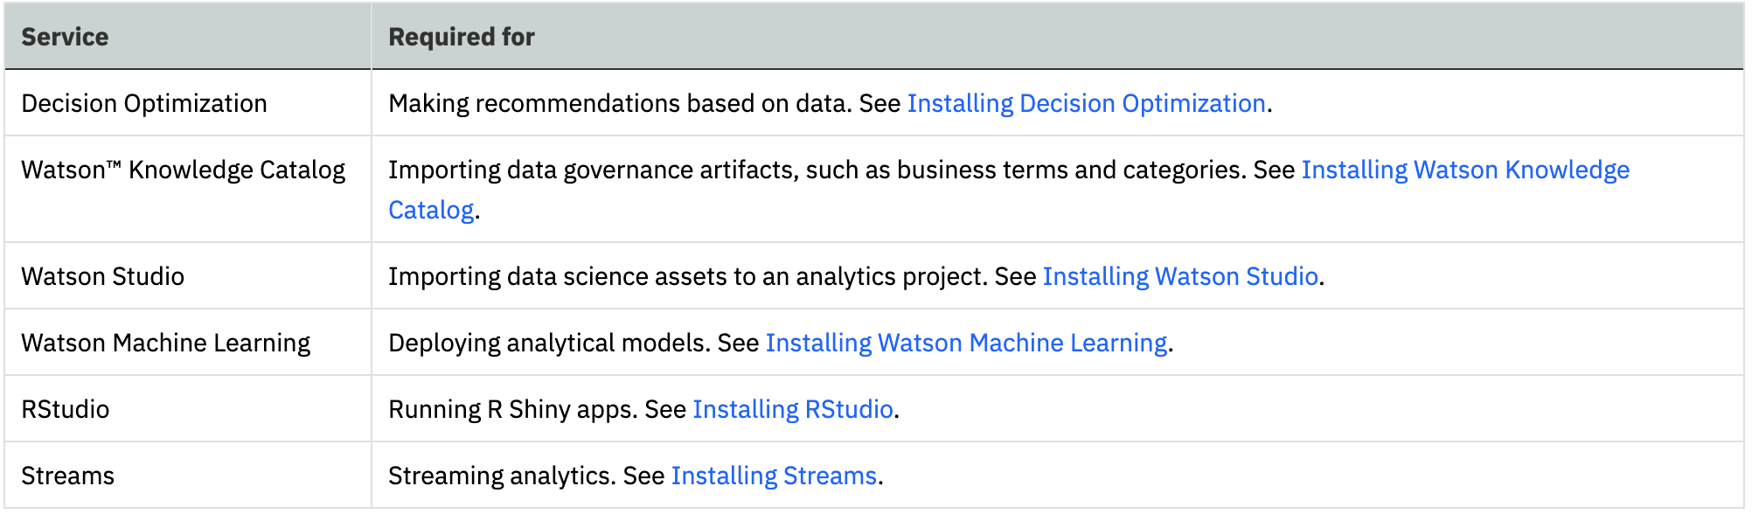

Slide 29
Integrations
Auditing your sensitive data with IBM Guardium

Slide 30
Lab
Tutorial on importing remote data for use with Cloud Pad for Data Industry Accelerators

Slide 32
Do you want to talk about Installation, you might want to… because services will be easy after that..

Slide 33
Reference Links
https://www.ibm.com/support/producthub/icpdata/docs/content/SSQNUZ_current/cpd/svc/svc.html

